Slide 1






Big Data in Finance
Gold Futures Return Prediction and Trading Strategy
Team 3
Alfred Choi
Sicheng Li
Paul Janicot
Sonyi He

Slide 2
I. Data Preparation How do we select the suitable data for prediction?
Gold Futures data (Bloomberg)
Choose the most liquid market with high open interest, which is current month +1 & +2.
Macroeconomic data (Bloomberg and Internet)
Gold futures is significantly influenced by many macro-economic factors, and considered as safe heaven asset.
Moskowitz, Ooi, and Pedersen (2012), Time Series Momentum
“we compute the daily excess return of the most liquid futures contract (typically the nearest or next nearest-to-delivery contract), and then compound the daily returns to a cumulative return index from which we can compute returns at any horizon”
Categories | Data | Economic Justification
Currency | DXY (USD), JPY | Gold is priced in USD, JPY regarded as safe heaven
Yield | 2Yr Yield, 10 Yr Yield, Fed Eff Rate | Affects excess return, increase opportunity cost of non-yield asset
Market Valuation | SPX P/E, SPX D/P | If market is overvalued, investors may invest in gold for diversification
Inflation | CPI, PCE, PPI | Gold serves as inflation hedge during high inflation and weak dollar
Econ Growth | GDP, Unemployment, Consumer Confidence | Historically, gold prices exhibited an inverse relationship with stock market and economic performance
Market | SPX, Nasdaq, VIX
Gold Demand & Supply | ETF Ounce, Chinese premium disc, Indian premium disc | ETF market and local gold market reflect the demand of gold and price premium that affects price
Daily Price
Past
1M Ret
3M Ret
6M Ret
12M Ret
Fwd
1M Ret
3M Ret
6M Ret
12M Ret
Excess Return
Monthly Return

Slide 3
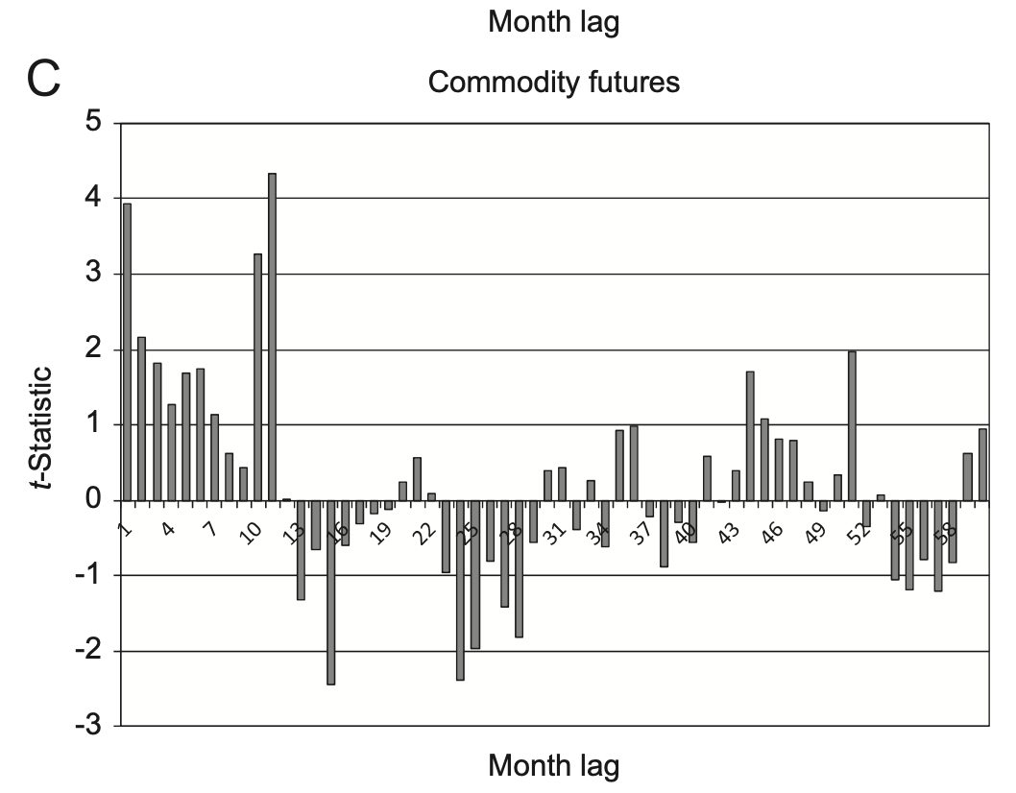
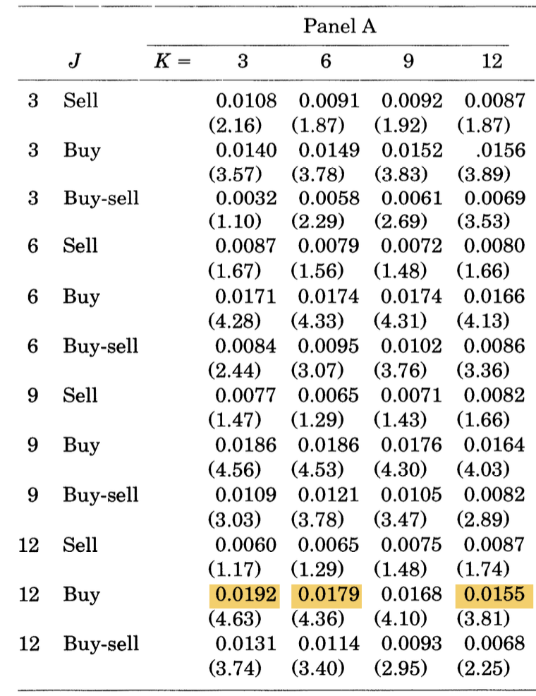
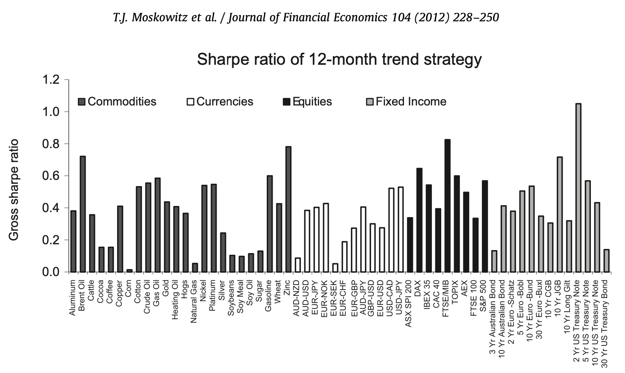
II. Model Intuition What models do we build?
Inspired by academia time series momentum strategy:
We forecast excess return after N month holding period, with following ML models:
Moskowitz, Ooi and Pederson (2012) - right: Momentum works positively for month lag 1 to 12 and significantly for gold, with sharpe ratio enhancement (12 month strategy)
We prefer excess return because it eliminates bias from risk-free return (compared to total return), and it gives clarity for signal identification, direct comparison and absolute performance (compared to sharpe ratio)
Jegadeesh/ Titman (1993) - left: For stocks market, long the best perform and short the worst perform bucket in past J month for next K months generates positive significant return.
X1
Macro Factors
Option 1
Lasso Regression only
Option 2
Random Forest with Lasso filtered (non-0) features
24 features
X2
Past J (1,3,6,12) Month Excess Ret
Log returns
Y
Excess Ret after Next K (3,6,12) Month
gold
Option 3
Random forest with ALL features

Slide 4




III. Data Cleansing and Model Construction How do we cleanse data and train model appropriately?
Besides dataframe formatting, we have done the following data pre-processing…
How do we perform in-sample training and out-of-sample testing?
1. Shifting: To prevent data leakage, all features are shifted by one month. For macro features like CPI - released later than month-end, we apply an extra one-month shift to maintain data integrity. This ensures that no future data, unavailable at the forecast time, is used.
1. Hyperparameter tuning: For Lasso regression model, we apply grid search to loop through the regularization parameter (λ) to find the best match that reduces error and eliminates some features.
2. In-Sample Train/ Out-of-Sample Test Split: We follow Goyal and Welch (2008) method, which “uses only the data available up to the time at which the forecast is made”. For example:
2. Standardization: Since LASSO regression requires all features on the same comparable scale, we standardize all features to prevent disproportionate shrinkage.
1975 – 90 Dec
91-95
← 96 Jan
Train Calibrate Test
91Feb- 96 Jan
343 CV folds
1975 – 91 Jan
← 96 Feb
.
.
.
2019Jul – 24Jun
1975 – 2019 Jun
← 2024 Jul

Slide 5
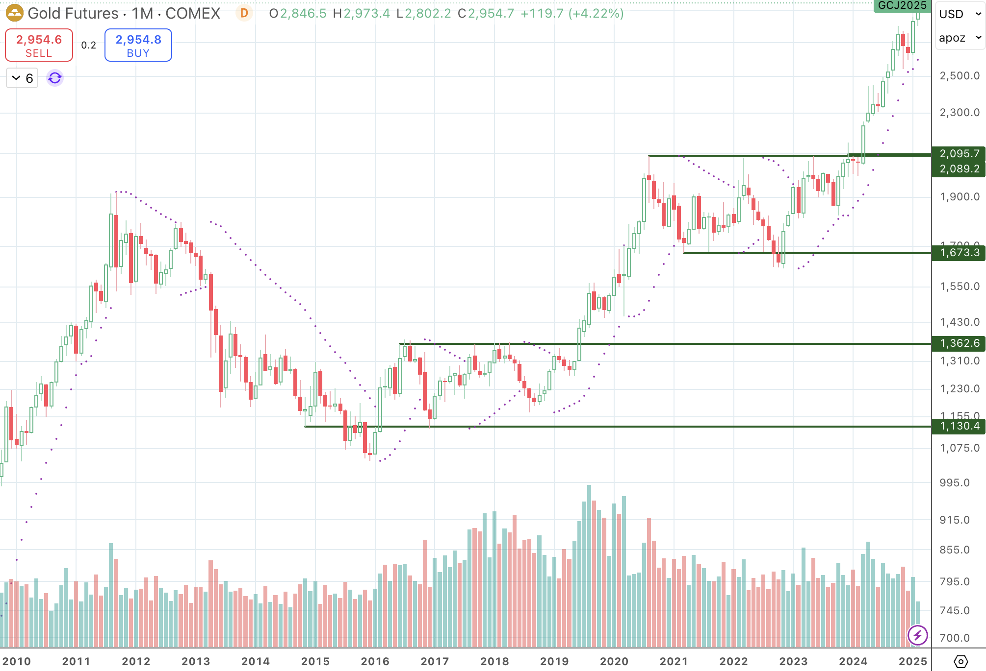
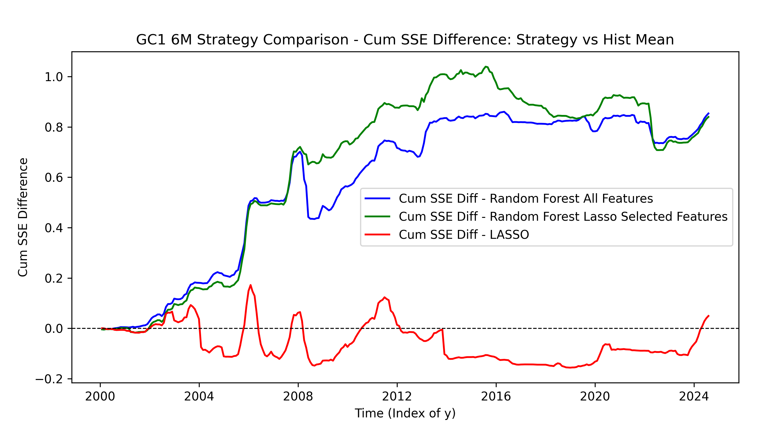
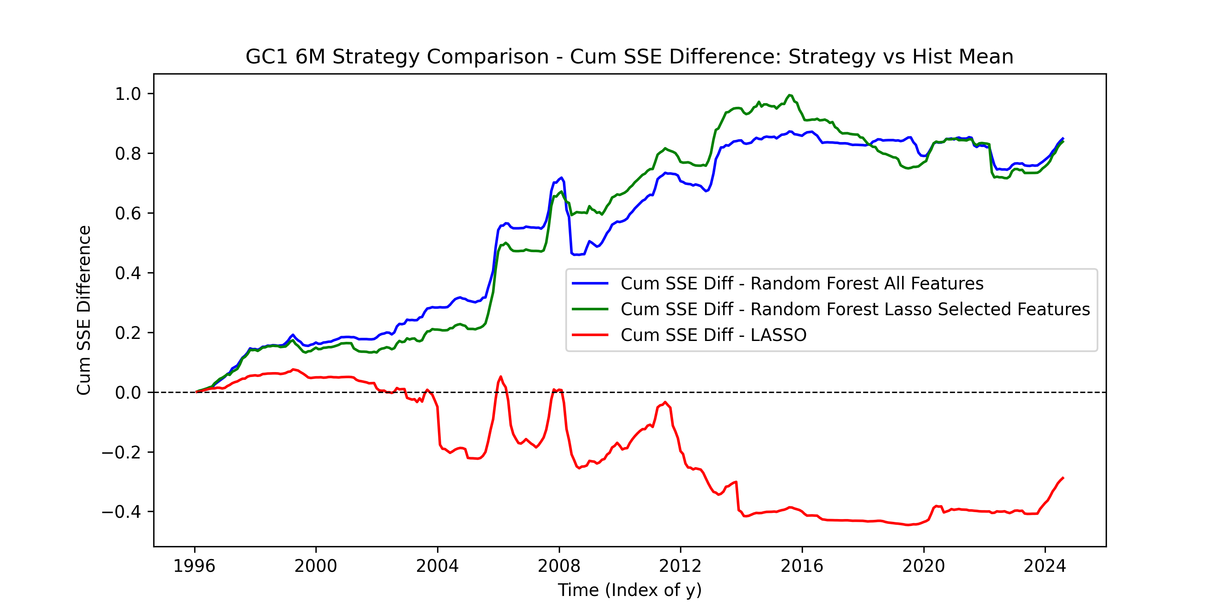
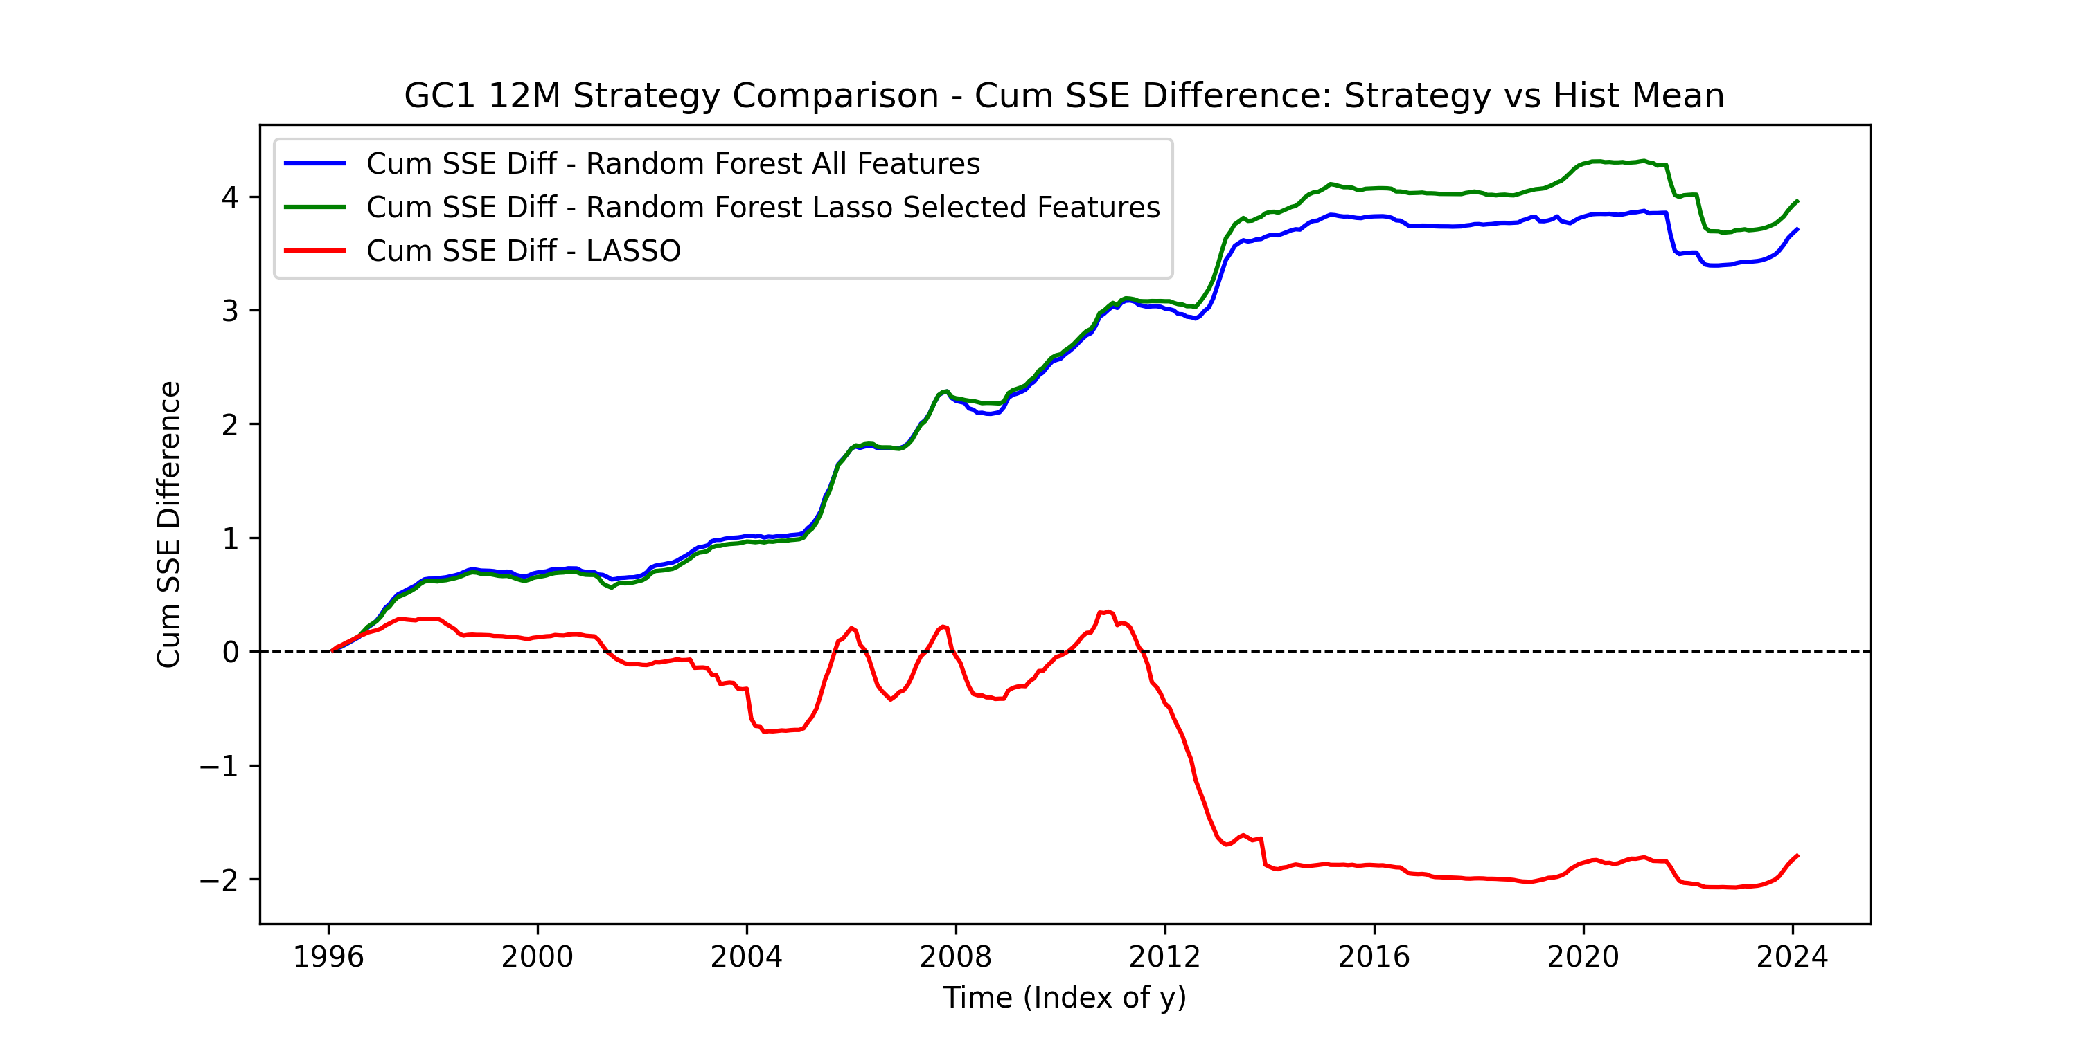
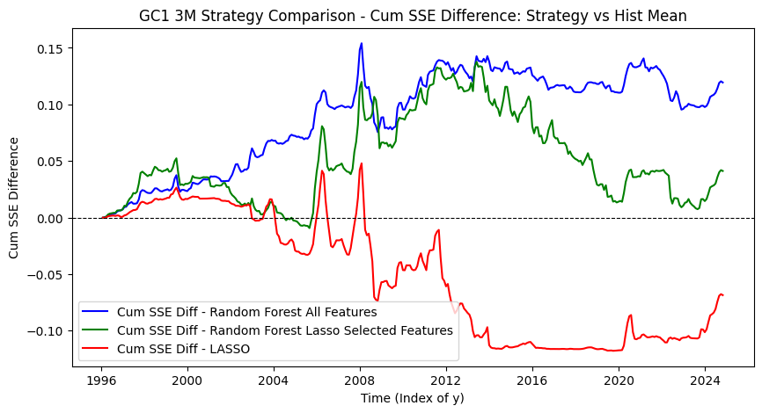
IV. Model Evaluation How well do the 3 models predict gold futures excess return?
Gold Futures, Monthly, 2010 -2025
1. Lasso performs poorly in prediction (worst than historical mean), because it cannot capture the non-linear relationships of the features.
2. For cumulative SSE difference, random forest performs better for longer-term holding period returns (6 or 12 months), suggesting that long-term trends are easier to forecast than short-term fluctuations, which are often obscured by noise.
6M Holding
Train: 1985
Test: 2000
3. The random forest with lasso-selected features fluctuates more than the full-feature model, with a significant drop in cumulative SSE difference for 3M & 6M holding periods between 2016 and 2019, likely because the Lasso filter removed many features, adversely affecting its prediction performance.
4. Both random forest prediction models struggle when the market moves sideways rather than trending up or down.
3M Holding
Train: 1975
Test:1996
6M Holding
Train: 1975
Test:1996
12M Holding
Train: 1975
Test:1996

Slide 6

Train start: 1975, Test start:1996
IV. Model Evaluation Which features matter most in the LASSO filter and in the full-feature Random Forest model?
Lasso features that are used more than 33% of the time for either 3M, 6M, 12M
Full-Feature Random Forest top 10 important features ranked (6M ,12M)
Features | 3M | 6M | 12M
GC1_6M_Ret | 0 | 343 | 337
GC1_12M_Ret | 346 | 343 | 155
US Gov 10Yr Yield | 85 | 272 | 299
US_Unemployment | 141 | 261 | 337
GDP_Nominal_YOY | 161 | 258 | 337
PPI | 70 | 180 | 252
JPY Curncy | 7 | 176 | 23
US Gov 2Yr Yield | 229 | 174 | 83
GDP_Real_QoQ | 118 | 174 | 337
US Real Interest Rate | 71 | 139 | 311
ETF_Ounces | 123 | 117 | 120
Fed Effective Rate | 114 | 17 | 22
Consumer Confidence | 36 | 67 | 251
Indian premium disc | 67 | 41 | 133
Rank | 6M Features | Importance
1 | PCE CYOY Index | 0.167
2 | GDP_Nominal_YOY | 0.119
3 | US_Unemployment | 0.095
4 | CPI YOY Index | 0.091
5 | GC1_12M_Ret | 0.078
6 | US Real Interest Rate | 0.062
7 | GDP_Real_QoQ | 0.057
8 | GC1_6M_Ret | 0.055
9 | PPI | 0.054
10 | ETF_Ounces | 0.030
Rank | 12M Features | Importance
1 | PCE CYOY Index | 0.200
2 | GDP_Nominal_YOY | 0.189
3 | PPI | 0.086
4 | CPI YOY Index | 0.086
5 | US Real Interest Rate | 0.084
6 | GC1_12M_Ret | 0.072
7 | US_Unemployment | 0.060
8 | ETF_Ounces | 0.041
9 | GC1_6M_Ret | 0.039
10 | GDP_Real_QoQ | 0.027
6-month and 12-month past returns, along with macro factors, are most influential for gold futures excess return prediction. Stock market movements and valuations have little impact.

Slide 7


V. Trading Strategy Setup How can we build a trading strategy based on model predictions?
Back Testing Period Choice:
1996 Jan – 2024 Dec
2000 Jan – 2024 Dec
Style:
Long-Short
Long only
Transaction cost
No cost
10 bps/ trade (real-life)
Investment Threshold
+/- 2% (can be tuned)
Signal is generated monthly based on forecast.
Capital is allocated equally among holding periods. Each month, only the portion indicated by the signal is invested, and the realized holding period return is converted into a monthly return for trading plot comparisons. (e.g. 3% 6M return → 0.5% return for the invested month)
Signal is generated based on the following rule:
Excess Return < -ve threshold
Invest in Gov risk free rate
Excess Return > +ve threshold
Excess return forecast
0 +/- Investment Threshold

Slide 8
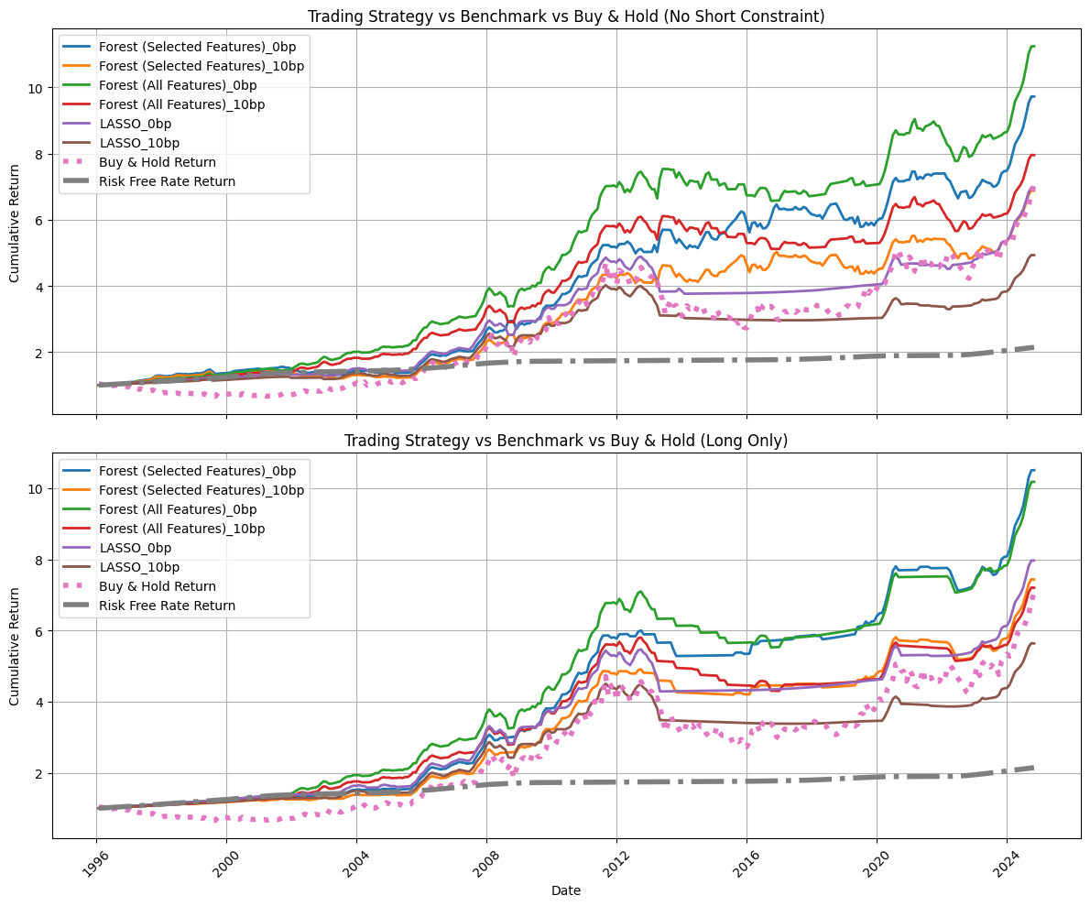
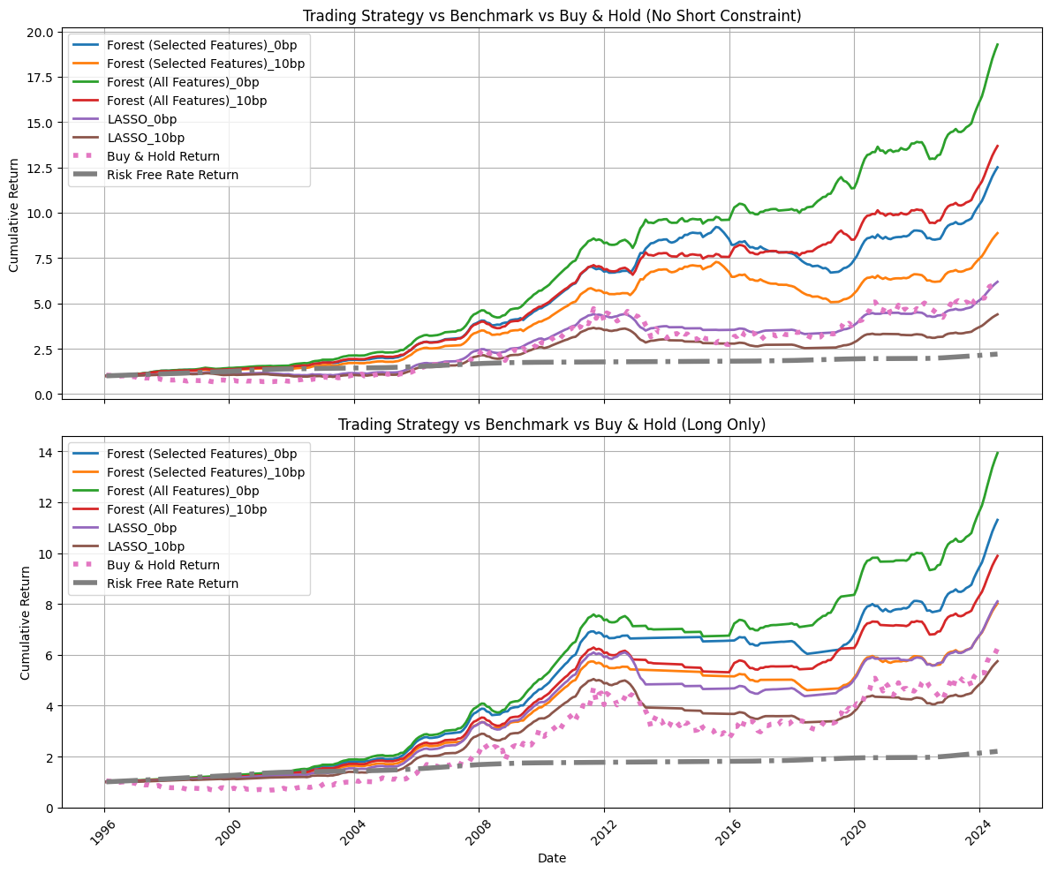
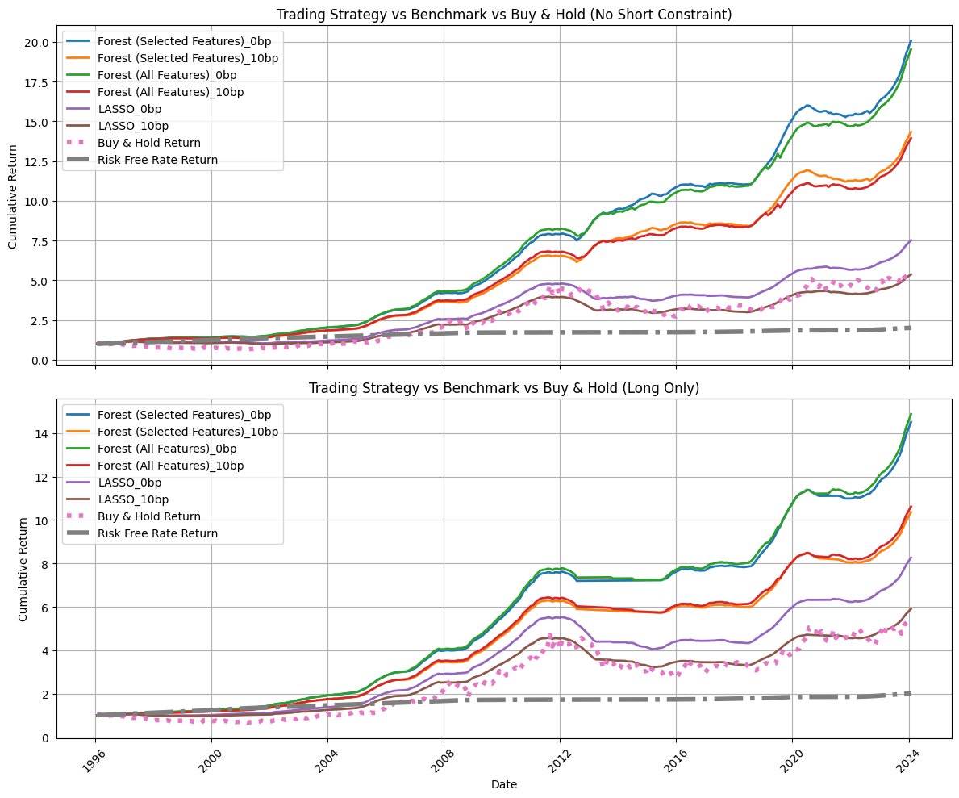
VI. Trading Strategy Evaluation Does our strategy outperform buy-and-hold scenario?
3M, Start test 1996
6M, Start test 1996
12M, Start test 1996
For 6M, Full-feature random forest (green and red) predict better and enhance investment return with multiple risk-free and short sell actions between 2016 and 2019.
Gold futures are better suited for long-term forecasting and investment strategies, as they deliver higher, smoother returns. It also narrows the performance gap between full-feature and selected-feature random forest models.
Lasso model does not provide good trading signal. Its performance after transaction cost is much worse than buy-and-hold strategy.

Slide 9
VI. Trading Strategy Evaluation Does our strategy outperform buy-and-hold scenario?
6M Holding Period,
Train start: 1975, Test start:1996
6M Holding Period,
Train start: 1985, Test start: 2000
Better sharpe ratio and return
Strategy | Transaction Cost | Final Value Per Dollar Invested | Annualized Return | 6M Sharpe Ratio | Max Drawdown | Win Rate | R2
Buy & Hold | - | 6.25 | 6.62% | 0.24 | -42.04% | n/a | n/a
Forest_All_F_LongShort | 0bp | 19.28 | 10.91% | 1.57 | -8.58% | 73.18% | 0.221
Forest_All_F_LongShort | 10bp | 13.68 | 9.58% | 1.31 | -9.12% | 73.18% | 0.221
Forest_All_F_LongOnly | 0bp | 13.93 | 9.65% | 1.44 | -11.35% | 73.18% | 0.221
Forest_All_F_LongOnly | 10bp | 9.89 | 8.35% | 1.17 | -15.49% | 73.18% | 0.221
Forest_Sel_F_LongShort | 0bp | 12.50 | 9.24% | 1.20 | -27.31% | 69.68% | 0.218
Forest_Sel_F_LongShort | 10bp | 8.87 | 7.94% | 0.96 | -30.44% | 69.68% | 0.218
Forest_Sel_F_LongOnly | 0bp | 11.30 | 8.85% | 1.32 | -12.76% | 69.68% | 0.218
Forest_Sel_F_LongOnly | 10bp | 8.02 | 7.56% | 1.03 | -19.67% | 69.68% | 0.218
Strategy | Transaction Cost | Final Value Per Dollar Invested | Annualized Return | 6M Sharpe Ratio | Max Drawdown | Win Rate | R2
Buy & Hold | - | 8.38 | 9.03% | 0.41 | -42.04% | n/a | n/a
Forest_All_F_LongShort | 0bp | 13.39 | 11.13% | 1.63 | -8.58% | 72.54% | 0.154
Forest_All_F_LongShort | 10bp | 9.97 | 9.80% | 1.39 | -9.12% | 72.54% | 0.154
Forest_All_F_LongOnly | 0bp | 11.13 | 10.30% | 1.57 | -11.35% | 72.54% | 0.154
Forest_All_F_LongOnly | 10bp | 8.29 | 8.98% | 1.31 | -15.49% | 72.54% | 0.154
Forest_Sel_F_LongShort | 0bp | 10.91 | 10.21% | 1.41 | -21.20% | 71.53% | 0.150
Forest_Sel_F_LongShort | 10bp | 8.12 | 8.89% | 1.17 | -24.30% | 71.53% | 0.150
Forest_Sel_F_LongOnly | 0bp | 10.16 | 9.89% | 1.47 | -14.96% | 71.53% | 0.150
Forest_Sel_F_LongOnly | 10bp | 7.56 | 8.58% | 1.22 | -21.50% | 71.53% | 0.150

Slide 10
VII. Discussion and Next Step
For coding, please refer to “gold_futures_data_0223.ipynb”, all dataframes and plot for the runs are saved in the folder name “generated_dataframe”
1. What is the commercial value for this study?
Investing in gold commodities provides portfolio diversification. Hedge fund managers may speculate on commodities to capitalize on directional trends. Machine learning systematic trading strategies offer commercial value to investors.
2. What economic interpretation can we learn from the features?
Focusing on longer holding periods (e.g., 6 and 12 months), past returns for these periods, as well as macroeconomic factors such as growth, unemployment, and inflation, are most influential. Yield also plays a role, as it relates to the risk-free rate and therefore excess return prediction.
As expected, stock market factors are less significant for gold returns, aligning with common financial findings.
3. Why does the trading strategy work?
Beyond model effectiveness, our focus is solely on directional bets rather than precisely predicting future returns, which is nearly impossible. We establish a threshold so that if the predicted excess return is close to 0%, we opt for a risk-free investment instead of taking a directional bet. This approach helps prevent excessive trading or unconfident guesses, preserves capital for future growth, and still generates some return—especially when the market is sideways or declining.
4. What can be further improved for the machine learning model and trading strategy?
We can further tune random forest hyperparameters and consider switching from an expanding window, which may overweight outdated data, to a rolling window approach. This is particularly relevant for older periods (e.g., 1970–1980) with volatile risk-free rates. Additionally, optimizing the investment threshold could enhance trading performance.

